Slide 1
Credit card fraud detection

Slide 2
Introduction
Reasons(due to which consumers are shifting from Debit card to credit card)
1.cashback & reward offers
2. Tie up credit card COMPANIES with online and offline merchants, especially during festive seasons
3. To maintain good cibil score
4. offers such as no annual fees or joining fees

Slide 3
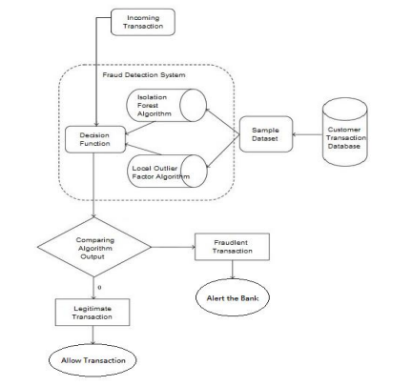

Slide 4
Credit Card Fraud Types
Card Not Present (CNP) fraud
Card Present (CP) fraud
Mail and telephone order (MOTO) fraud
First-party fraud
Identity fraud
Plastic fraud

Slide 5
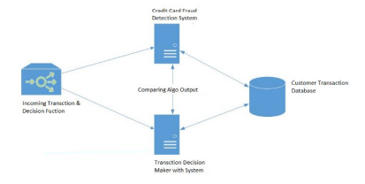

Slide 6
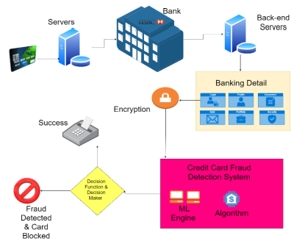

Slide 7
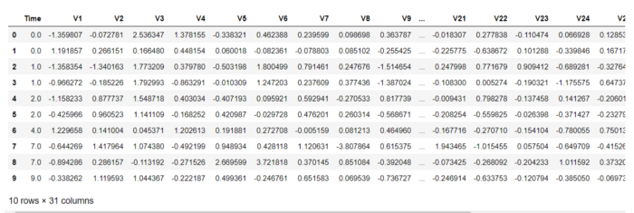
Dataset Description

Slide 8
Graphs to check data
1.Bar Graph(Fraudulent &non-fraudulent)
2.Line Graph(Time)
3.Boxplot(Outliers)
4.HeatMap

Slide 9
Algorithms
1.Decision Tree
2.K-Nearest Neighbors
3.Logistic Regression
4.SVM
5.Random Forest
6.XGBoost

Slide 10
Thank you…!

